Slide 1
Mobile Application Development - Day 15
Database

Slide 2
Database
SQLite
Room DB
Realm

Slide 3
SQLite
SQL is a standard language for accessing and manipulating databases
SQLite is a software library that provides a relational database management system.
Lite in SQLite means light weight in terms of setup, database administration and required resource

Slide 4
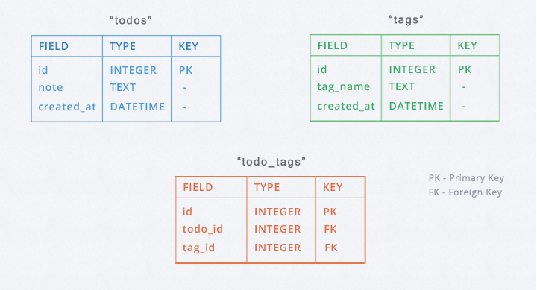
SQLite

Slide 5
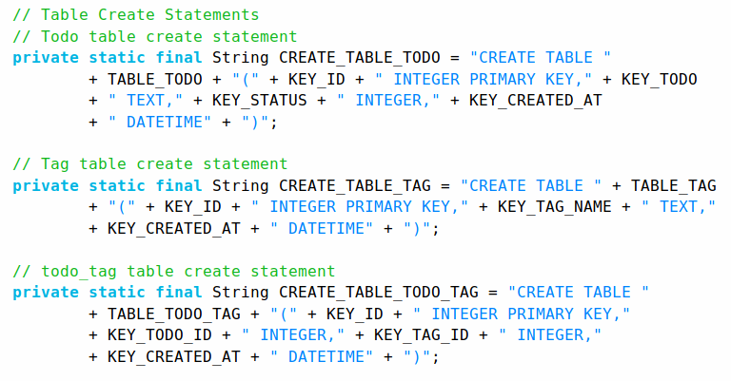
SQLite

Slide 6
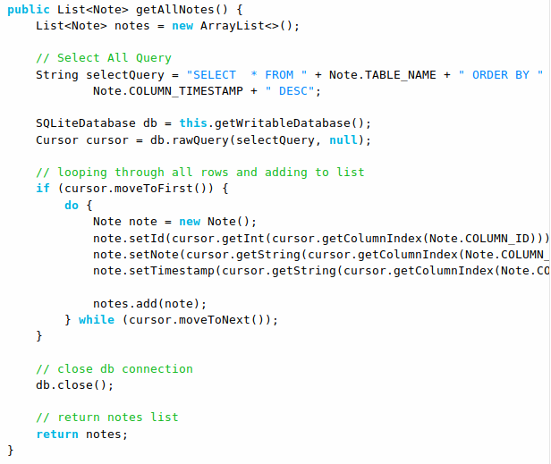
SQLite

Slide 7
Room DB
Room is a new way to create a database in android applications.
Room is a database layer on top of SQLite database
Room uses DAO(Data Access Object) to issue queries to its database
DAO is an abstract class or interface that includes methods to define database queries.
Room is much similar to ORMLite.

Slide 8
Room DB Components
Entity
Dao
Database

Slide 9
Room DB - Entity
Represents a table within the database.
Uses @Entity annotation
Fields in the class correspond to columns in the table
Entity Annotations
@PrimaryKey
@ColumnInfo

Slide 10
Room DB - Dao & Database
Dao
responsible for defining the methods that access the database
In SQLite, we use the Cursor objects but with Room, we don’t need all the Cursor related code
simply define our queries using annotations in the Dao class
Database
serves as the main access point for the underlying connection to your app’s persisted, relational data

Slide 11
Room DB - Dao
@Query("SELECT * FROM Book " +
"INNER JOIN Loan ON Loan.book_id == Book.id " +
"WHERE Loan.user_id == :userId "
)
public List<Book> findBooksBorrowedByUser(String userId);

Slide 12
Room DB - Dao
@Query(“select * from Students”) List<Students> getAllStudents()
@Query(“select * from Students where name=’student_name’”) List<Students> getAllStudents(String student_name)

Slide 13
Room DB - Setup
Define an abstract class that extends RoomDatabase
This class is annotated with @Database
Lists the entities contained in the database
Lists the DAOs which access entities.

Slide 14
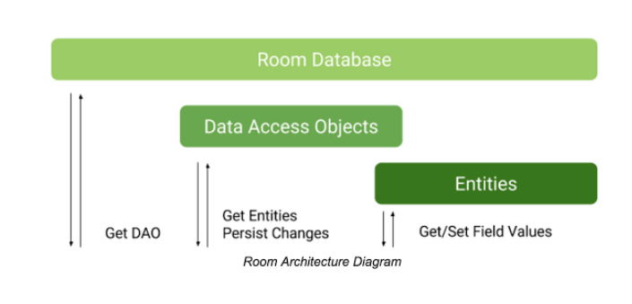
Room Architecture Diagram

Slide 15
ORM - Object Relational Mapping
framework used to map an object to a relational database
ORM is technique for storing, retrieving, updating and deleting from an object oriented program in a relational database.
Object-relational mapping in computer science is a programming technique for converting data between incompatible type systems using object-oriented programming languages

Slide 16
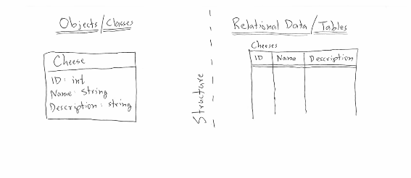
ORM

